Slide 1
How to Transfer Money from an External Account to your PNC Savings Account

Slide 2
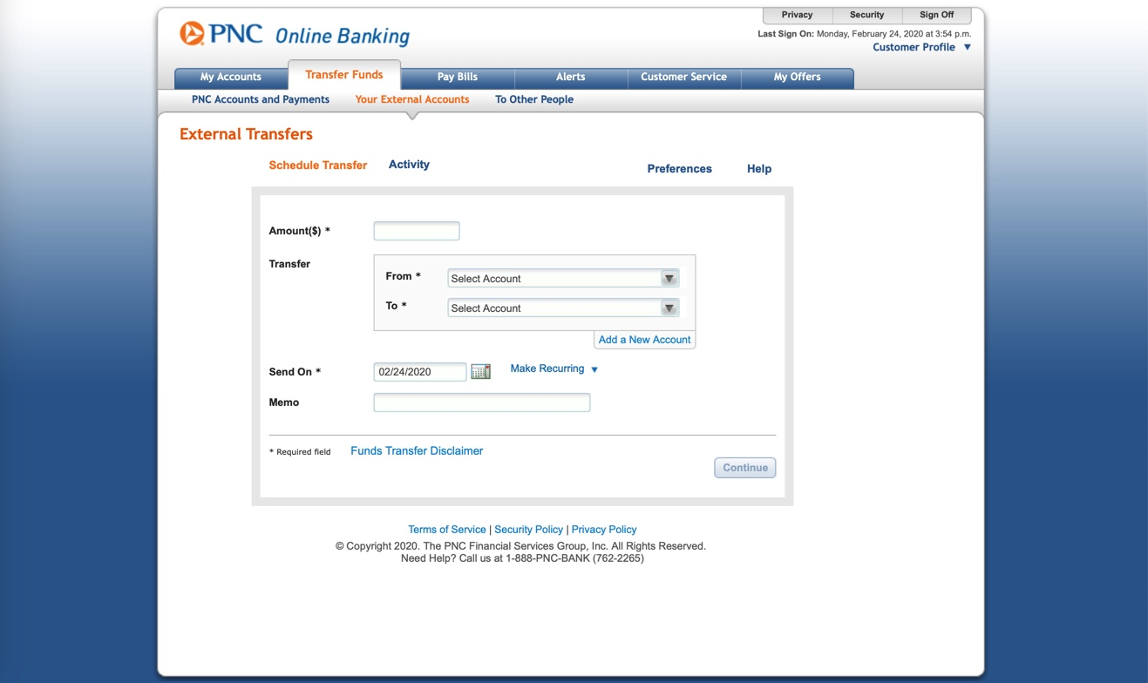
1. Enter Amount Here

Slide 3
2. Select the external account to transfer money from

Slide 4
3. Select the PNC account to transfer money to

Slide 5
4. Select the correct date

Slide 6
5. Optional: Add a memo before hitting
“Continue”

